Slide 1


Final Project
Part B summery
Gal. S.
Nadav. A.

Slide 2
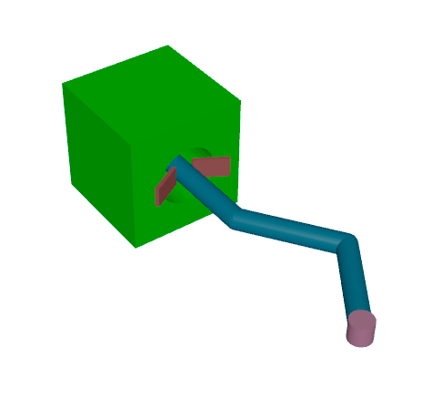
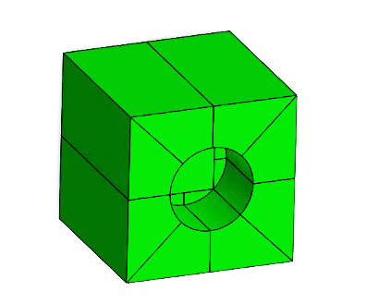
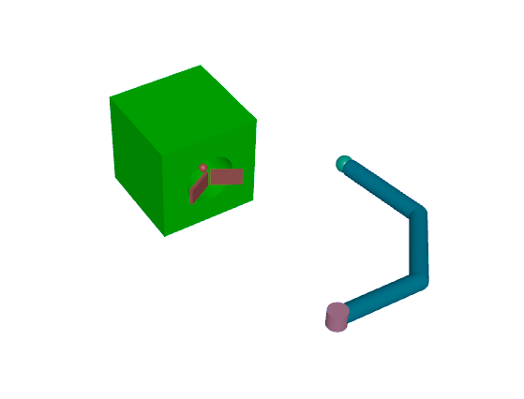
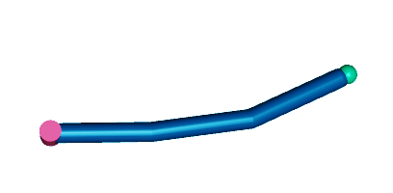
Reminder - Project Model
Navigation target
End effector
represent cable tip
Hollow wiring box
Cad model
Hollow wiring box
3rd link
3rd motor
Pre tensioned
spring mechanism
2nd motor
2nd link
1st motor
1st link
Manipulator
model

Slide 3
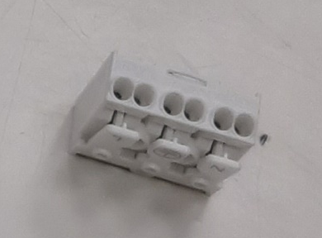

Project Goal
Insert a robotic end effector which represent a wire tip inside a model representing a wiring mechanism in an electrical cabinet.
Operation to be executed with minimal forces exertion.
Impedance controller was suggested as an solution.

Slide 4
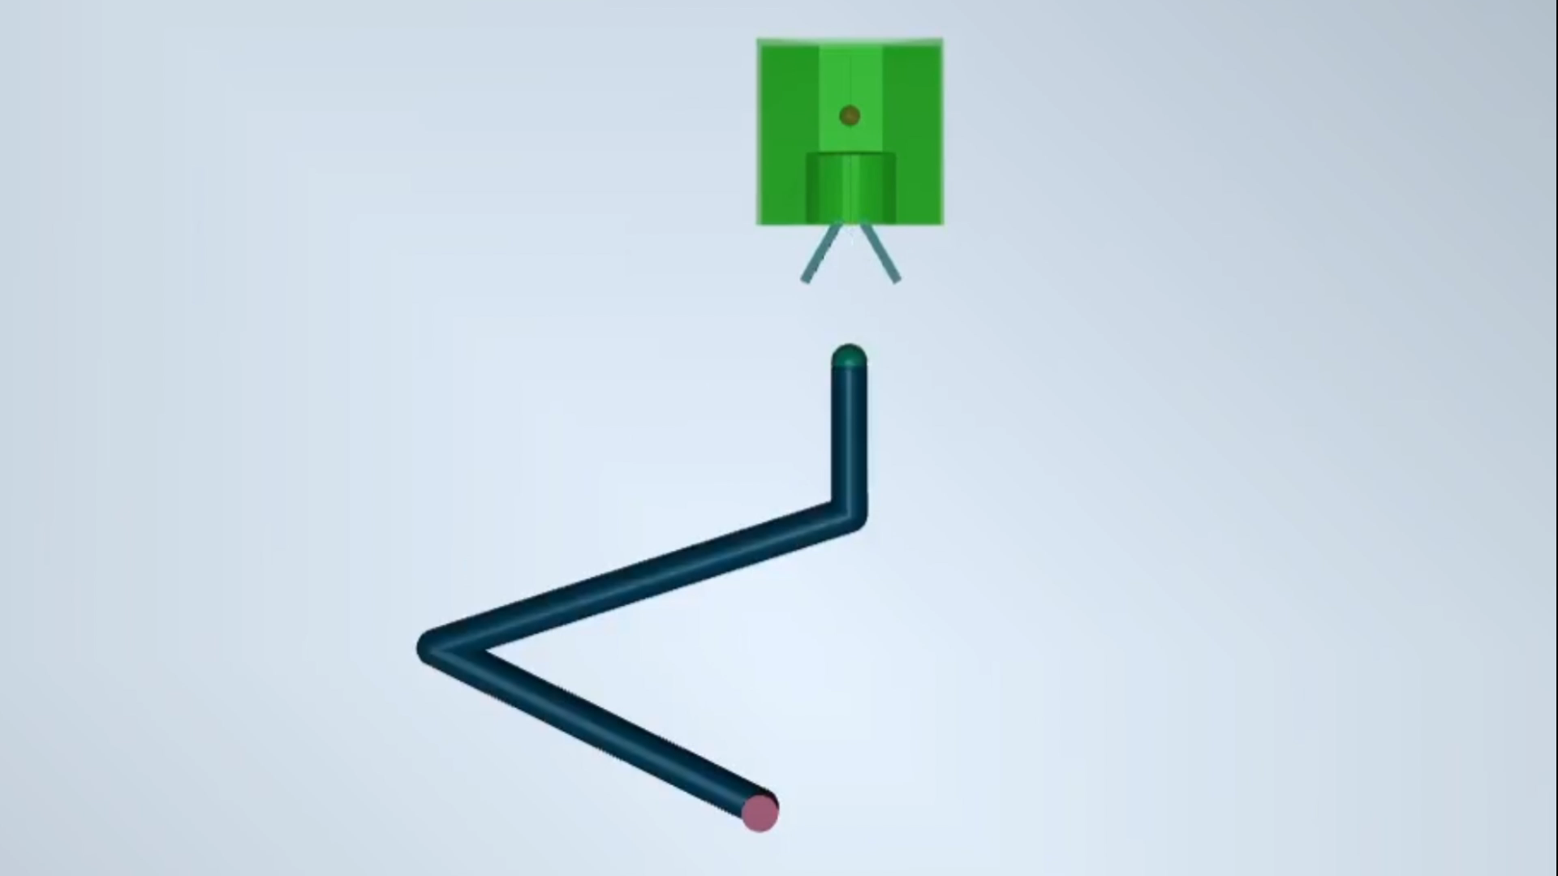
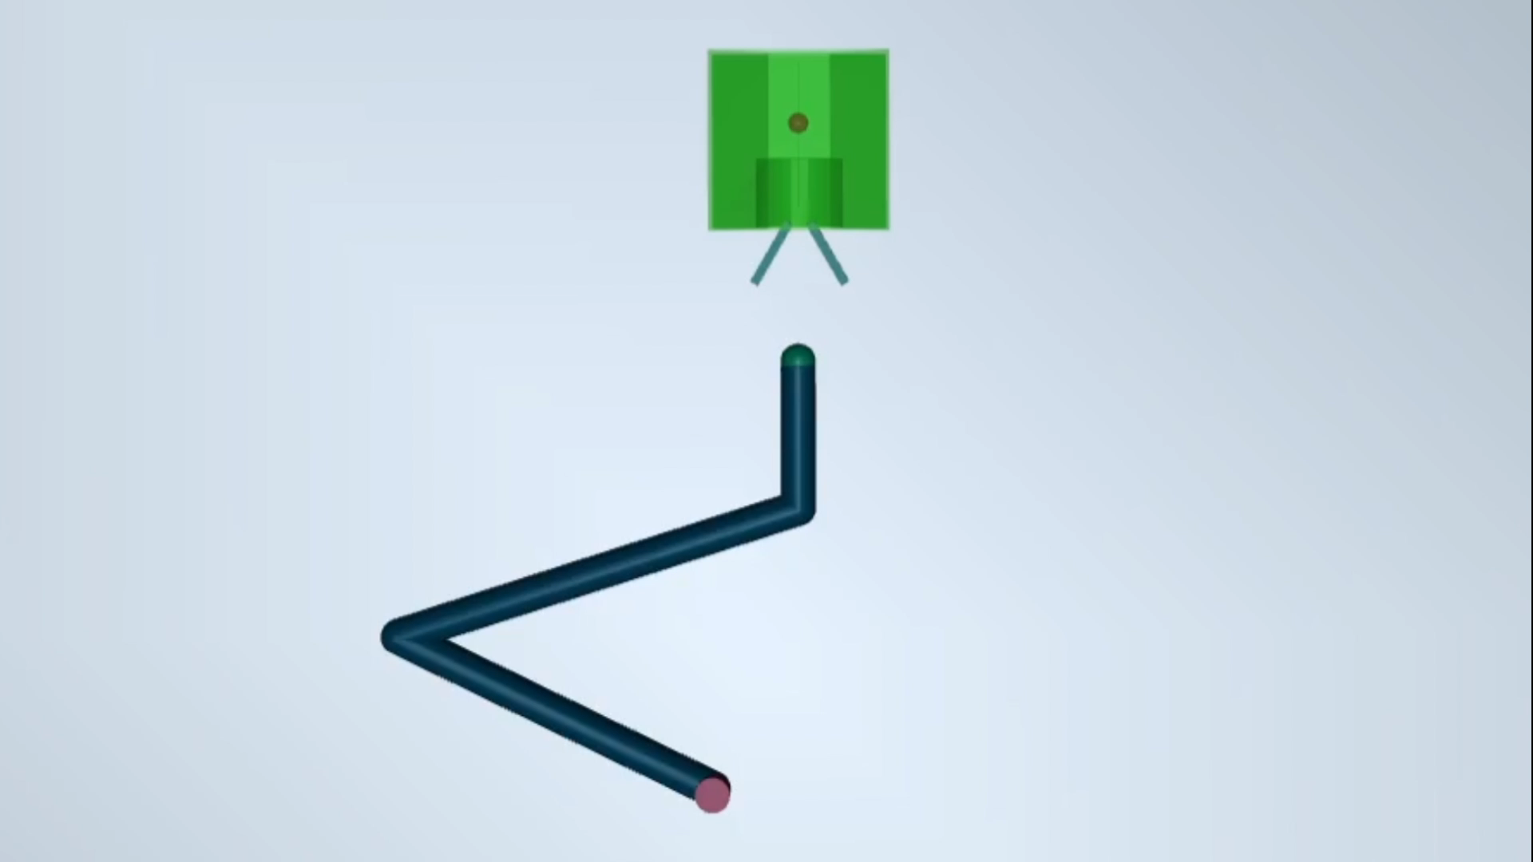
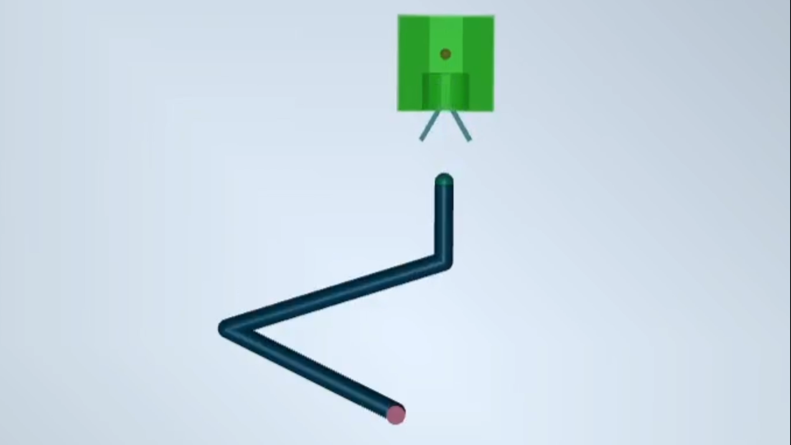
Reminder - Project part 1
PD control
Stiff Impedance control
Soft Impedance control
PB-IC Impedance controller implementation according to Zacksenhouse and Valency (2003)
NOTE: All simulations are 2 seconds long.
Videos time differences are due to CPU lags while calculating impedance behavior in real-time

Slide 5
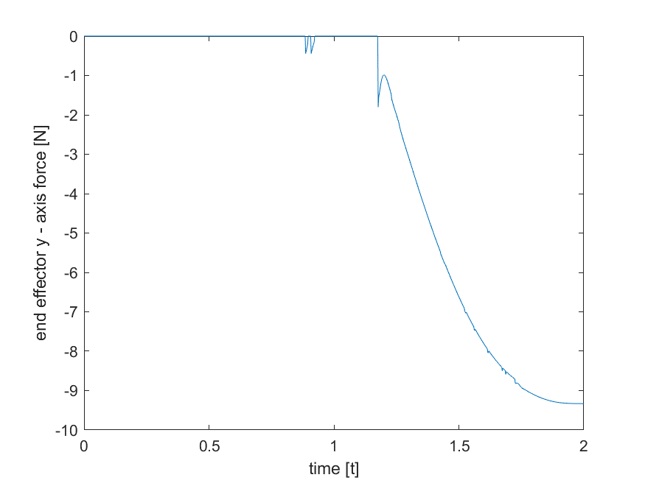
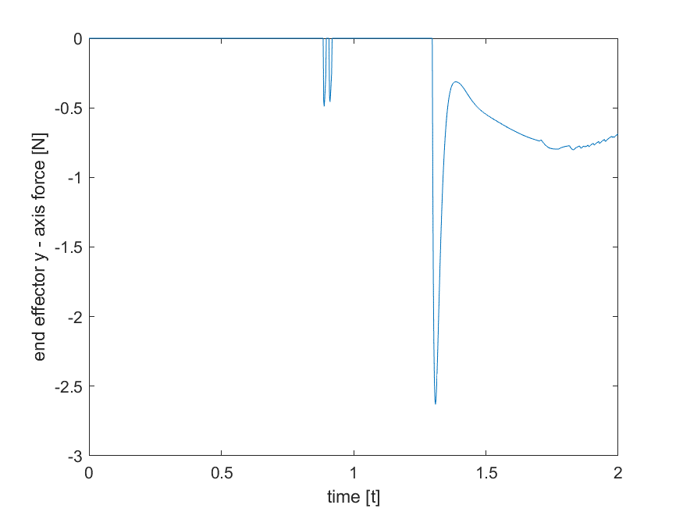
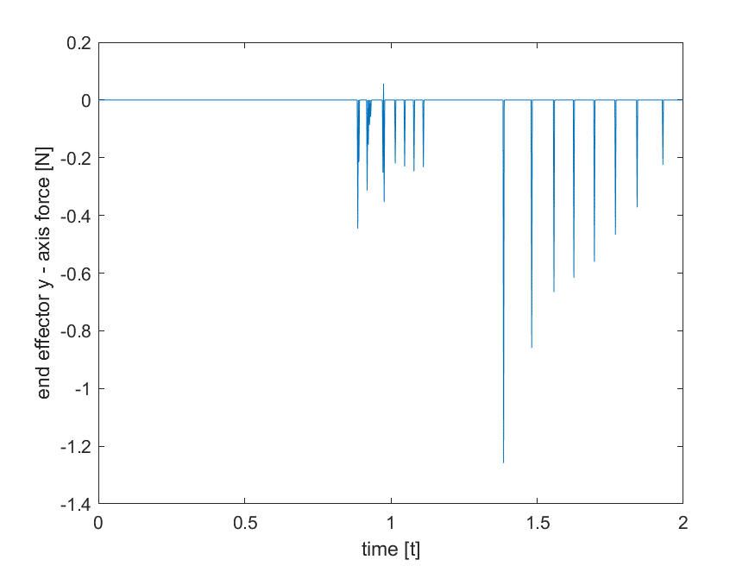
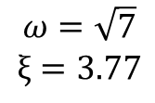
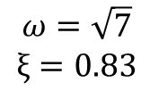
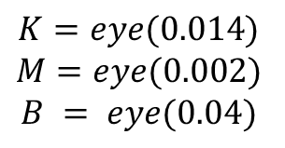
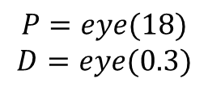
Graphs comprehension end effector sensor - y axis force
For all controllers:
Stiff impedance controller:
$$P=eye(18)$$
$$D=eye(0.3)$$
K=eye(1.26)
M=eye(0.18)
B = eye(0.8)
$$ω=\sqrt{7}$$
$$ξ=0.83$$
PD
Stiff Impedance controller
Soft Impedance controller
Soft impedance controller:
Soft Impedance controller
minimal Force exertion in order to complete the task
$$K=eye(0.014)$$
$$M=eye(0.002)$$
$$B = eye(0.04)$$
$$ω=\sqrt{7}$$
$$ξ=3.77$$

Slide 6
Soft Impedance behavior
Y axis trajectory
Trajectory
Spring mechanism contact
Y
X
Wall contact

Slide 7
Stiff Impedance behavior
Y axis trajectory
Trajectory
No evidence for contact!
Y
X
Wall contact
Wall contact

Slide 8

Part 2 - Our Goal
Teach A Robotic arm manipulator to wire an electric cable using machine learning tools.
Obtain generality in the fashion of boundary conditions of the problem.
Different positions of the manipulator relative to the wiring mechanism at time = 0.
Different types of wiring equipment.
Different types of robotic arm manipulators.
Obtain human like behavior.
1. PD behavior.
2. Minimum control effort and force exertion.
3. Impedance behavior.

Slide 9

Reinforcement Learning approach
Approach:
Problem classification:
Model Free
Continuous Action Space
Continuous State Space

Slide 10
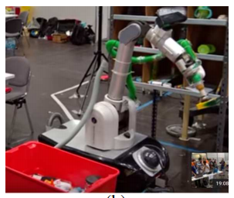
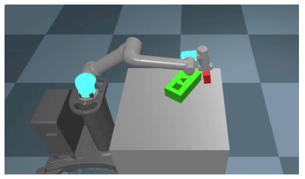
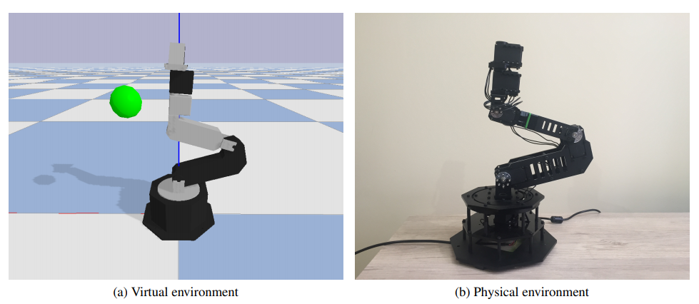
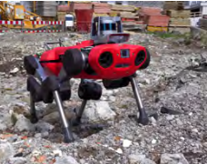
Reinforcement Learning background
Algorithms known to be compatible
with robotic tasks:
Link
Link
PPO
DDPG
A3C
A2C
D4PG
TRPO
Best performance in reaching tasks: DDPG, TRPO, SAC
Much More
Link
Link

Slide 11
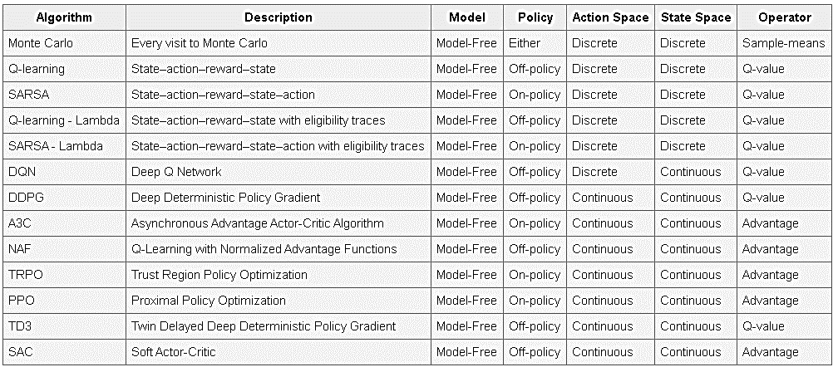
List of common RL algorithms
What we eventually chose to work with
Other algorithms
Optional algorithms
Class

Slide 12
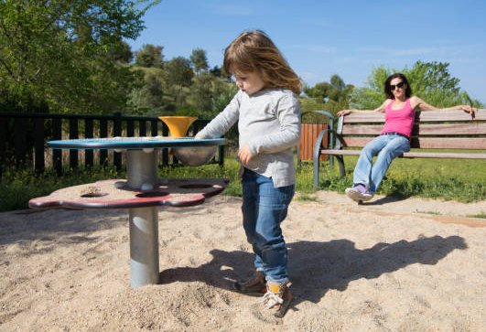
Deep Deterministic policy gradient (2014)
Action
Q value
Actor
network
Critic
network
Actor
Observation
Observation
Action
Critic

Slide 13
Deep Deterministic policy gradient (2014)
2 networks algorithm - aka actor and critic.
Deterministic policy gradient uses the critic as the loss function for the actor.
DDGP also addresses instabilities by:
Experience replay buffer for actor and critic.
2 target networks to freeze parameters, periodically updated.

Slide 14
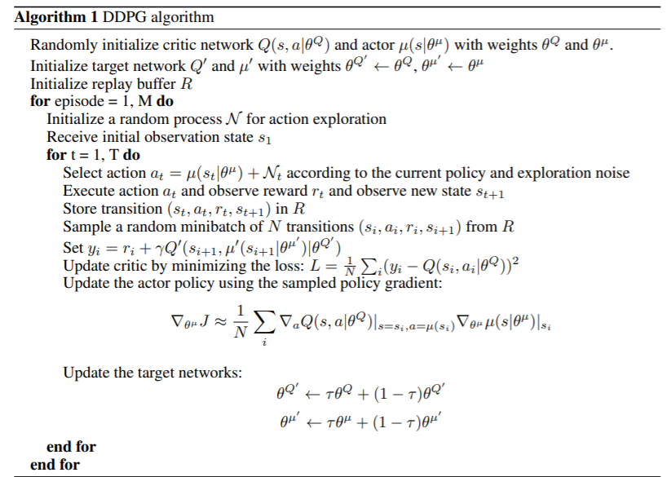


Slide 15
Robot sensing devices
Joint angles
Joint velocities
End effector position
End effector velocity
End effector forces (x,y) . Torque(z)
Target position

Slide 16

Learning properties
State & observation
Exploration Vs Exploitation
Other hyper parameters
Reward
Standard learning
Impedance learning

Slide 17
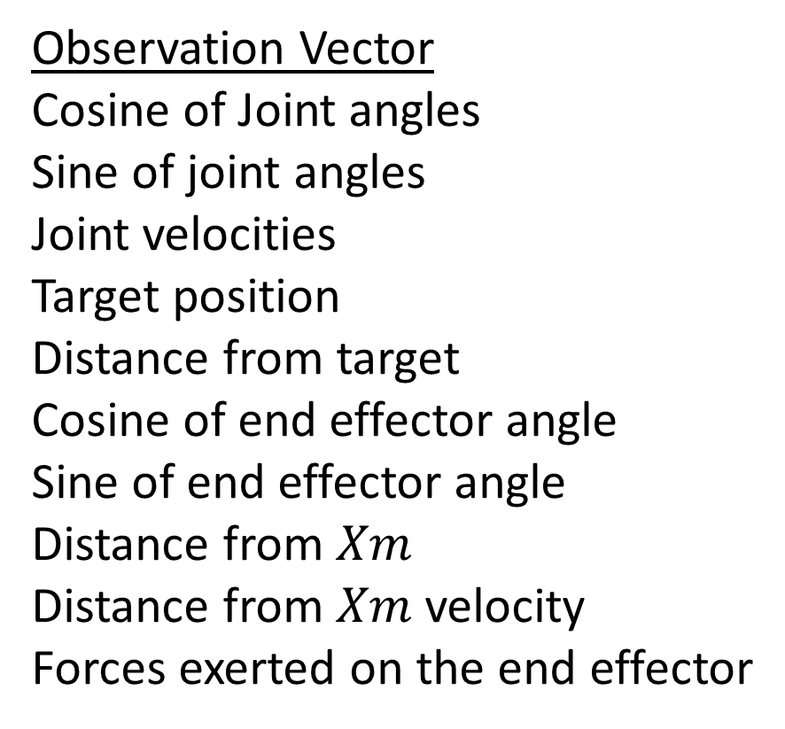
State and Observation
Both Standard and Impedance
Observation – data from the robot state and the environment.
Observation Vector
Cosine of Joint angles
Sine of joint angles
Joint velocities
Target position
Distance from target
Cosine of end effector angle
Sine of end effector angle
Distance from $Xm$
Distance from $Xm$velocity
Forces exerted on the end effector
Manipulator
Reward
Action
Environment
Impedance learning

Slide 18
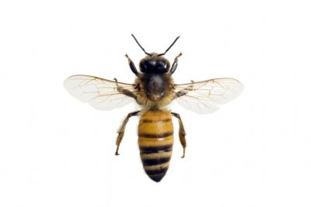
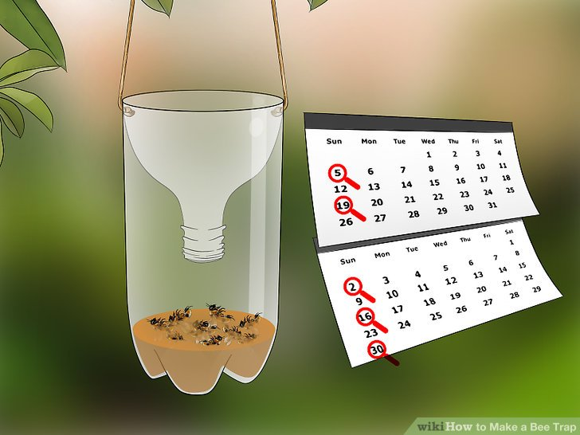
Exploration Vs Exploitation
Both Standard and Impedance
DDPG: While learning - Gaussian noise distortion is added to each action.
We used Exploration rates ranging from 0.05 to 0.3 - probability to act random while learning.
Exploration used to lock the robot into final
reward position.

Slide 19
Important Hyper Parameters
Both Standard and Impedance
Replay Buffer and Mini Batch size - saves old experience and randomly sample from it:
Big buffer size - saves experience from untrained agent.
Small buffer size - not enough information to train from.
Big mini batch - computational expensive, too much correlation between samples.
Small mini batch - computational cheaper, less correlation, longer learning rate.
Other important parameters:
learning rates, discount factor(gamma), Target change rate (Tau), etc.

Slide 20
Learning properties - Standard Reward Definition
Standard
Reward at each step:
Minimize distance from target
Minimize difference from desired end effector angle
Minimize forces exerted on the end effector
Final episodic reward if specific criteria are met:
We used: Bonus reward when final distance/angle from target is lower than a desired value.
More advanced ideas that we didn’t use:
Final penalty if during an episode the robot touched itself.
Reward regarding the length/shape of the trajectory.
Reward that aims to minimize the control effort.
Standard PD mimic
Minimal torques and forces

Slide 21
Reward field Visualization
Standard
Red background Force penalty zone: penalty is proportional to force magnitude.
Blue minuses location and angle penalty field.
Green pluses location and angle positive reward field.
Yellow plus
final reward .

Slide 22
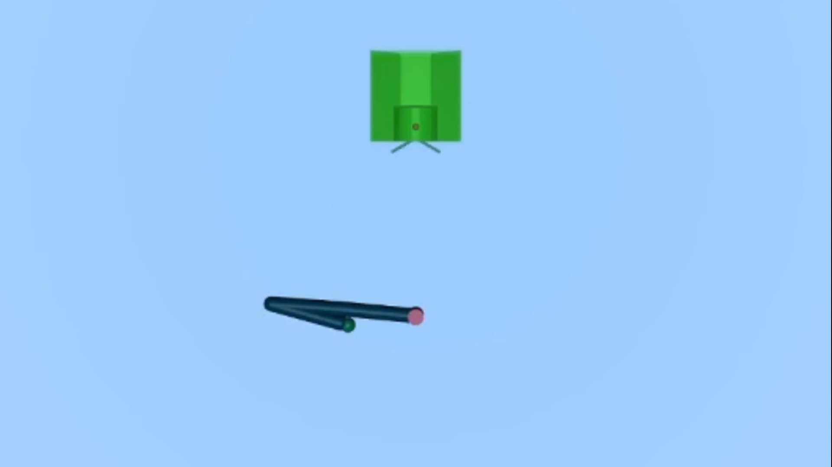
Robot behavior before learning applies to all cases
Standard

Slide 23
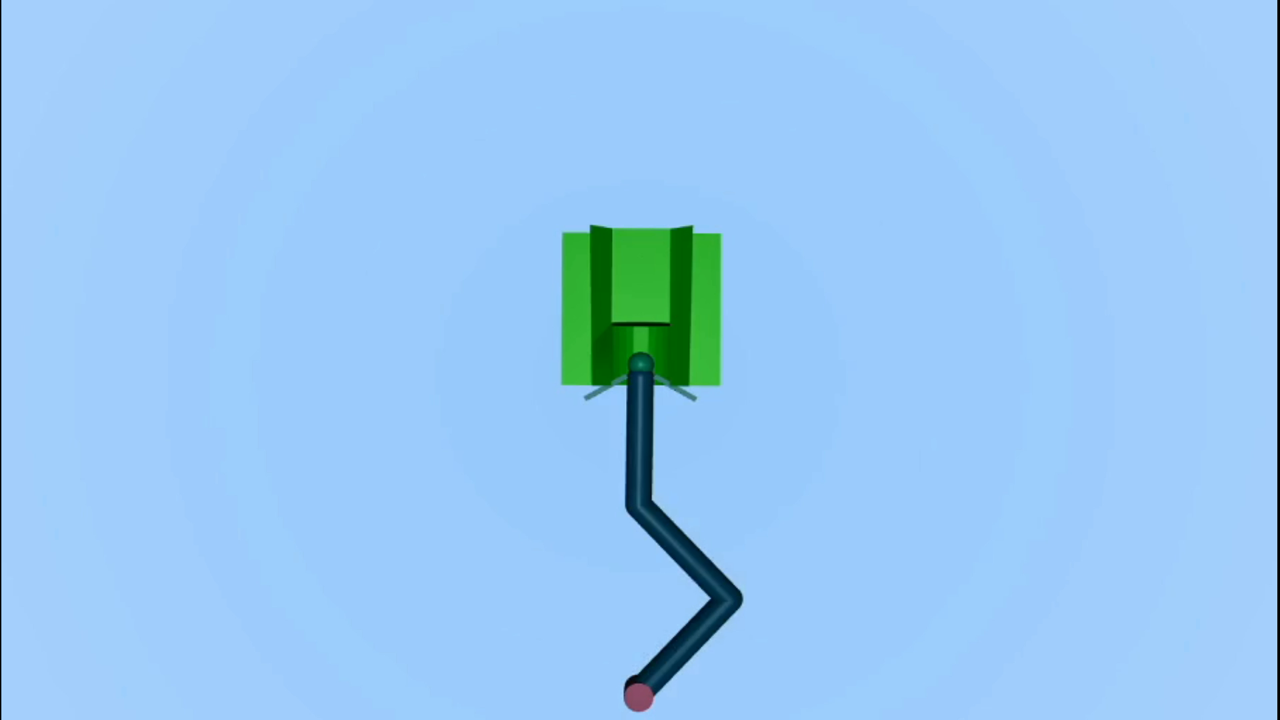
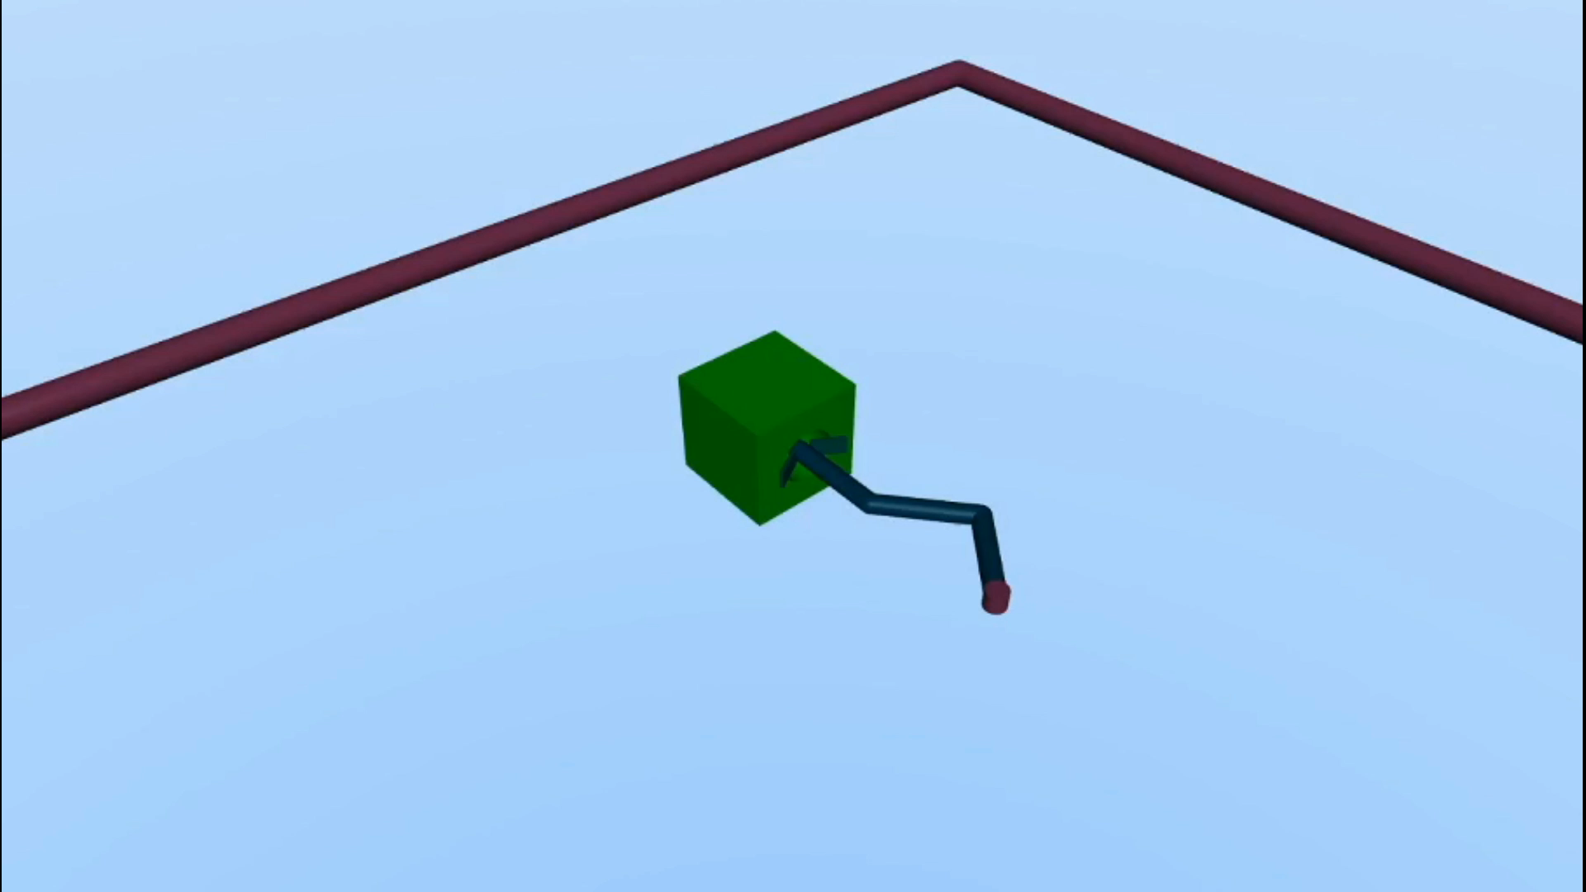
Robot after 200K learning steps standard learning
Standard
Random start location.
Robot learned to avoid hitting the wiring box!
Force penalty , Location reward, Angle reward, Final reward for reaching the target

Slide 24
Graphic results
Standard
Trained agent success rate in mission is over 90%
We believe that this percentage can be improved as function of training steps.
Agent lock into final reward position
reward

Slide 25
Q value functions
Standard

Slide 26
Actor and Critic performance
Standard

Slide 27
Impedance behavior learning
Impedance
2 different approaches to solve the same problem.
Approach 1
Approach 2
Path tracking
Behavioral
Change when forces are greater than zero

Slide 28
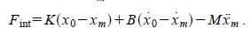
Approach 1 main idea
Impedance Approach 1
Based on Zacksenhouse and Valency article, PB-IC (similar to 1st part)
Step 1: beginning of each episode
Build trajectory vectors from initial point to the target denoted by .
Initialize to be the end effector’s position and velocity .
Step 2: each time step
Solve the following ODE for , Using current and online forces vector measurement.
ODE:

Slide 29
Approach 1 main idea
Impedance Approach 1
Step 3: each time step:
Reward the agent with respect to .
Reward =
This approach was the natural step-up from the 1st part of the project.
The approach turned out to be computational
expensive and converges slowly.
The agent learned the control law.
s
Target
xm
trajectory
Current location
Start point

Slide 30
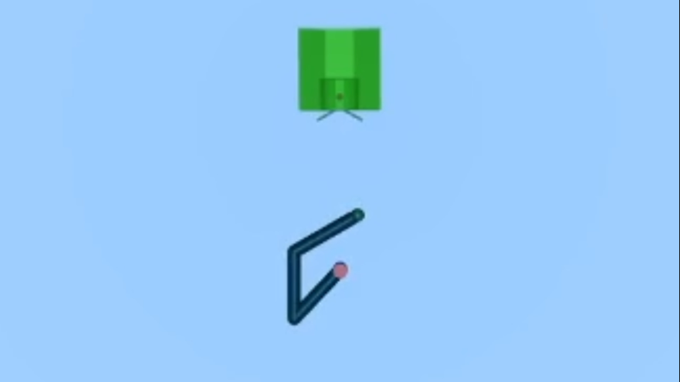
Approach 1 main idea
Impedance Approach 1
Robot learned to follow a specific path

Slide 31
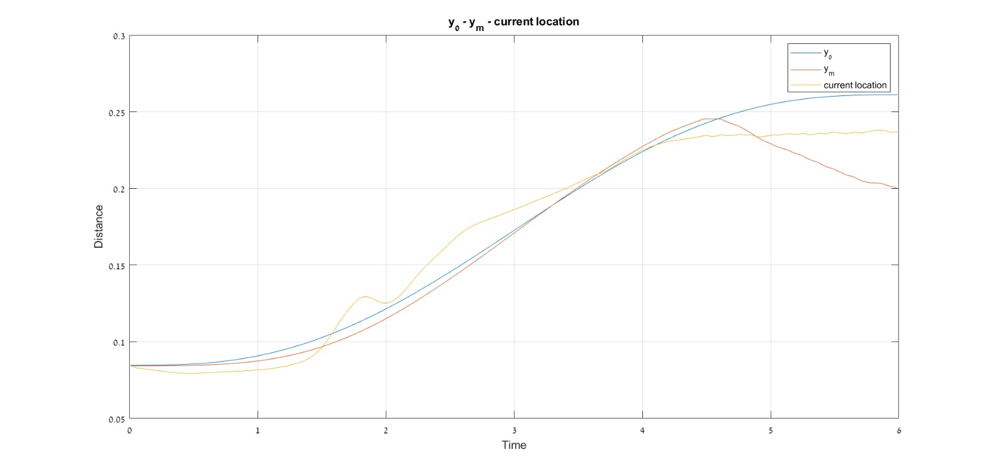
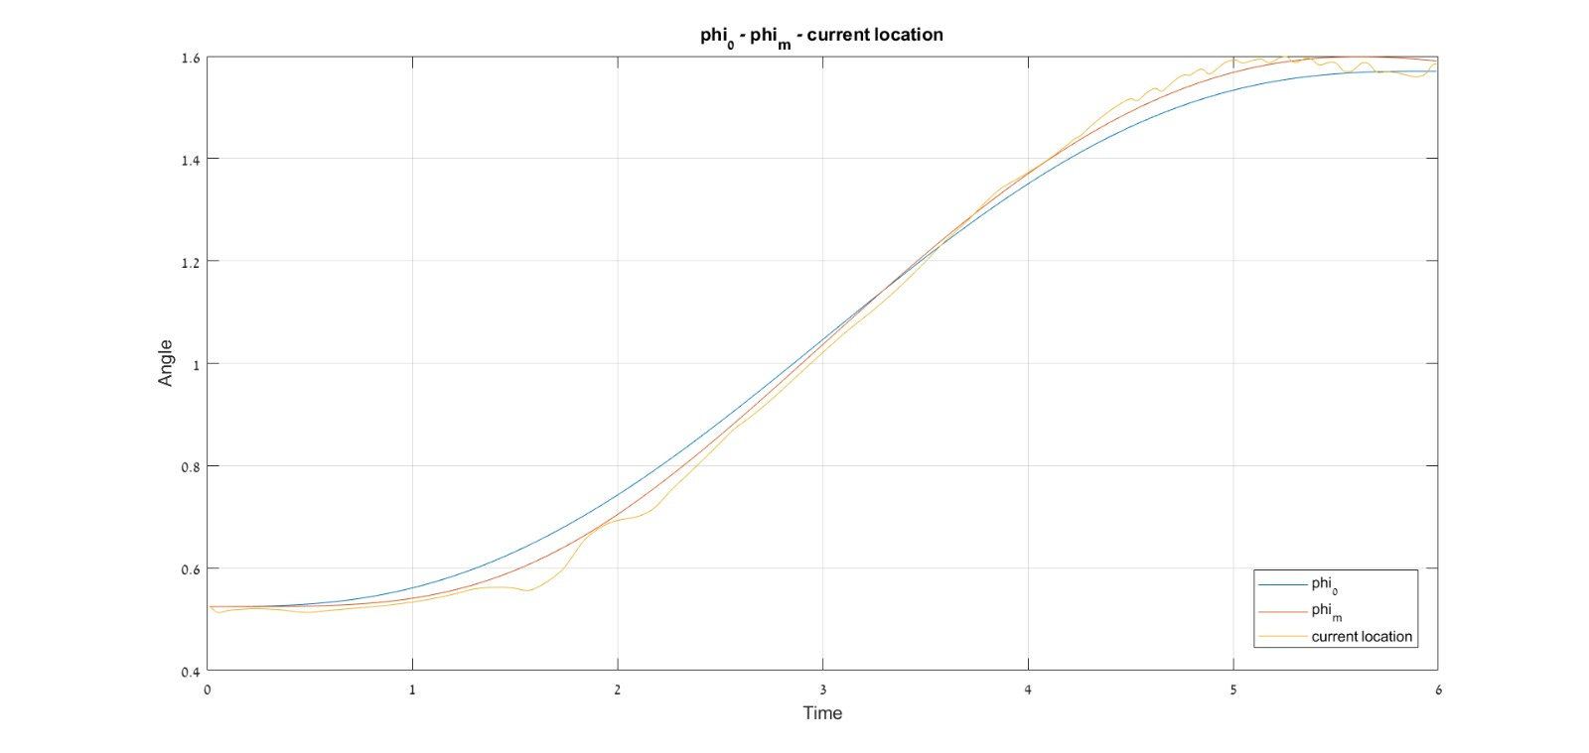
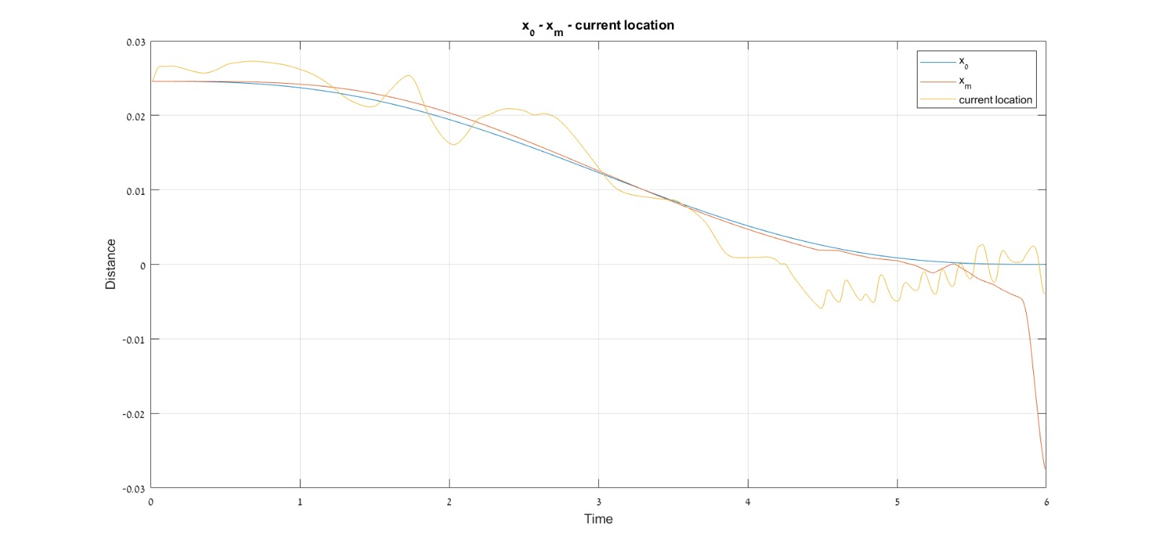
Approach 1 performance after 700K steps
Impedance Approach 1
Robot hits springs

Slide 32
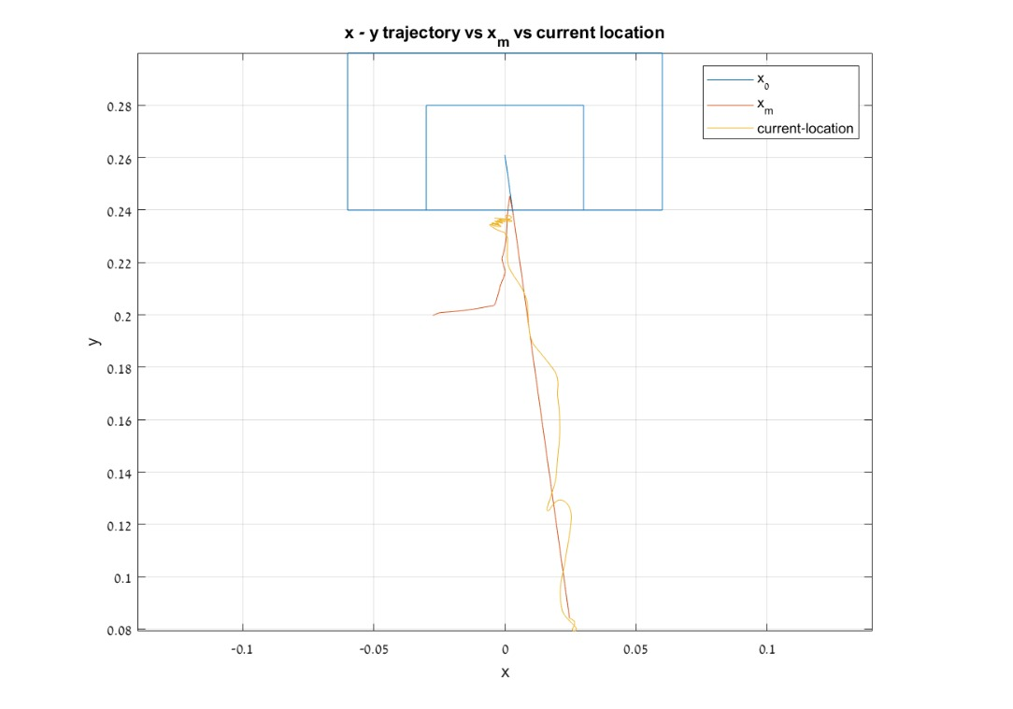
Approach 1 performance
Impedance Approach 1
Robot displays path tracking without the need to use a control law
Impedance behavior caused the robot to behave softly when contacting the springs,
Hence preventing it from entering

Slide 33
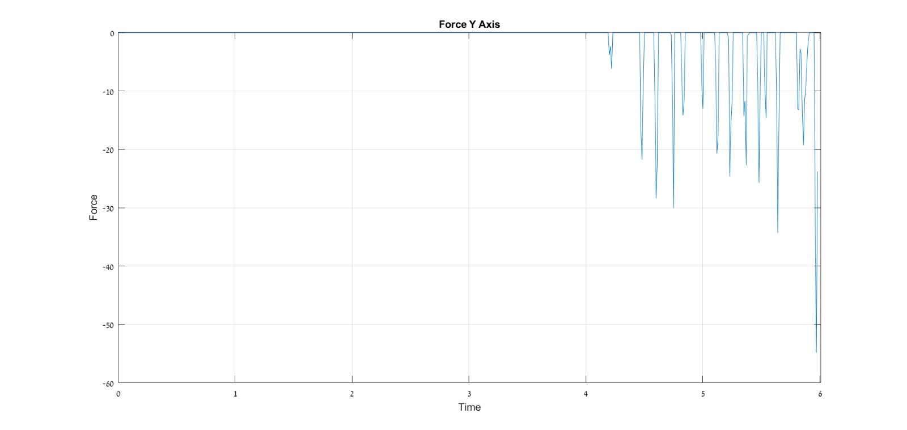
Forces
Impedance Approach 1

Slide 34
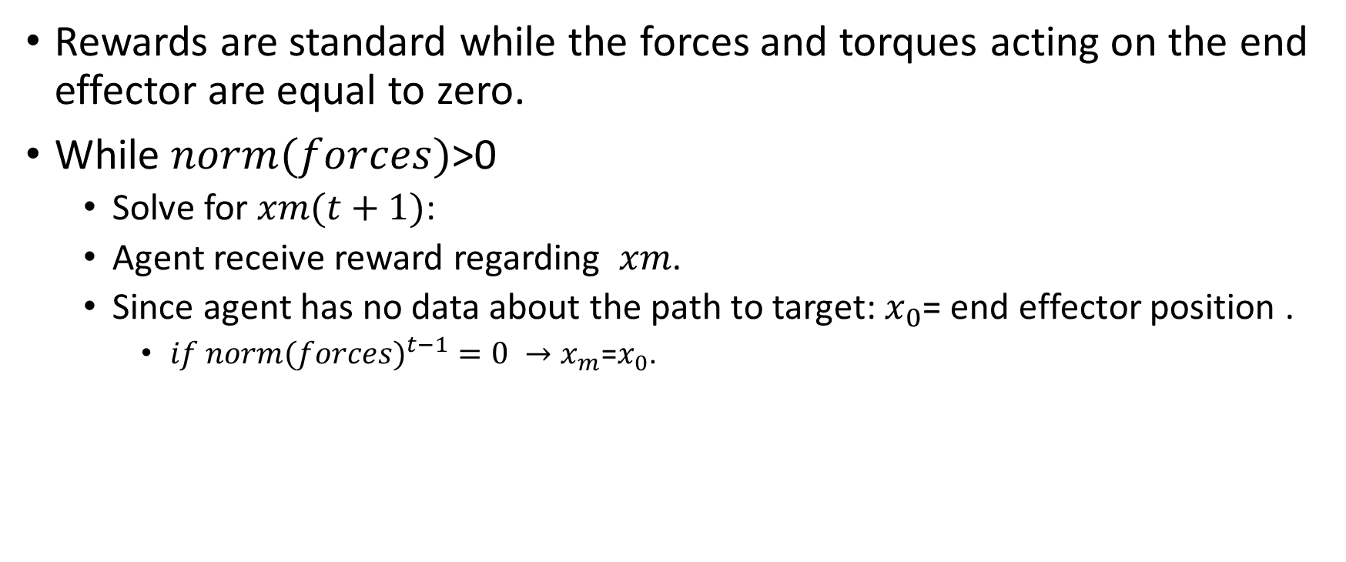
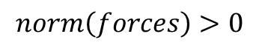
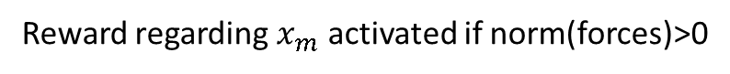
Approach 2 main idea
Impedance Approach 2
Rewards are standard while the forces and torques acting on the end effector are equal to zero.
While $norm(forces)$>0
Solve for $xm(t+1)$:
Agent receive reward regarding $xm$.
Since agent has no data about the path to target: $x_{0}$= end effector position .
${if norm(forces)}^{t−1}=0 →x_{m}\text{=}x_{0}$.
Visualization of soft robot manipulator
Reward regarding target position. Deactivated if norm(forces)>0
Reward regarding $x_{m}$ activated if norm(forces)>0
End effector position.
Arrow represents direction of momentary acceleration
$$norm\left(forces\right)>0$$

Slide 35
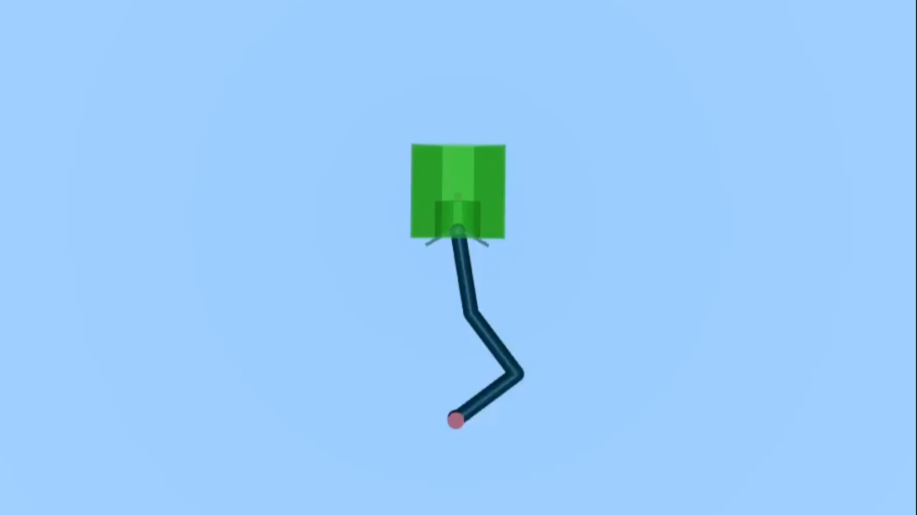
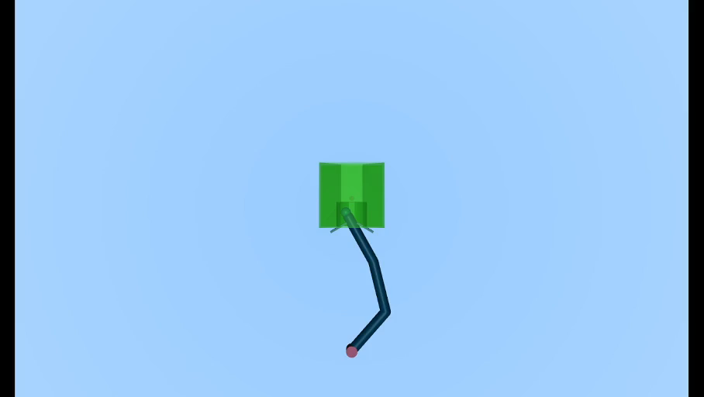
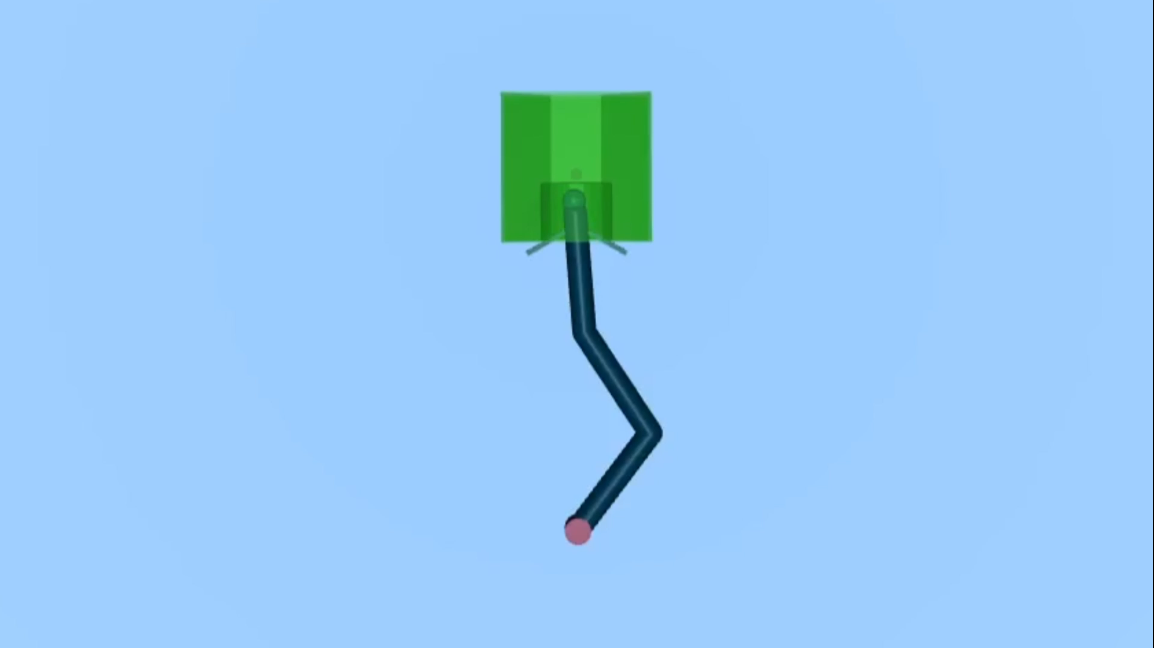
Approach 2 performance simple comparison
Impedance Approach 2
Standard learning
without force penalty
Stiff Impedance agent
Soft Impedance agent
For simplification purposes: No angle rewards as been given and starting point was constant
NOTE: All simulations are 0.2 seconds long.
The model we used for this set of simulations is scaled compared to the model that we used in the first part. Therefore forces are scaled.

Slide 36
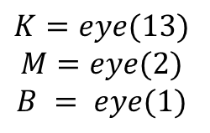
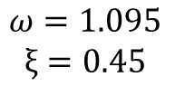
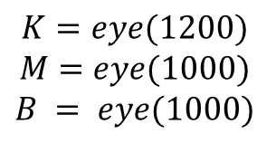
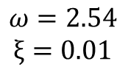
Approach 2 performance end effector sensor - y axis force
Impedance Approach 2
$$K=eye(13)$$
$$M=eye(2)$$
$$B = eye(1)$$
$$ω=2.54$$
$$ξ=0.01$$
$$K=eye(1200)$$
$$M=eye(1000)$$
$$B = eye(1000)$$
$$ω=1.095$$
$$ξ=0.45$$
Standard learning
With force penalty
With threshold of
1000[N]
Standard learning
Not shown as video

Slide 37
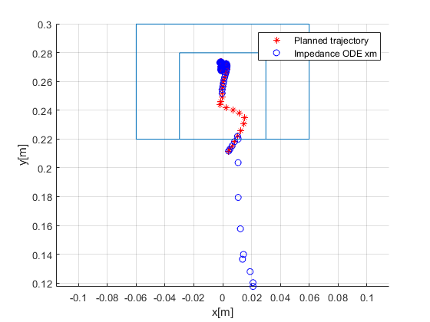
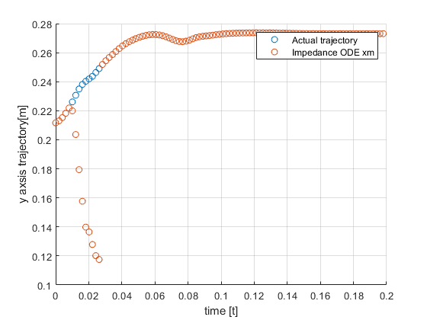
Soft impedance behavior
Impedance Approach 2
Trajectory
Y axis trajectory

Slide 38
Summery
 | PD | Impedance | Standard RL With force penalty | RL impedance approach 1 | RL impedance approach 2
% Success | 100 | 100 | >90 | N/A | >90
Forces | high | adjustable | adjustable | adjustable | Somewhat adjustable
End effector Stiffens controllability | Not possible | Easley controlled By changing impedance parameters | Can be controlled by adjusting force related rewards | controlled By changing impedance parameters | Somewhat controlled by changing impedance parameters
Learning time (steps) | N/A | N/A | 1 hour to obtain good performance (200K steps) | Several hours for each specific trajectory (800K steps) | several hours to obtain good performance (400K steps)
Adaptation to surroundings | X | V+ | X | V | V

Slide 39

Thank you

